Slide 1

Banking the Unbanked:
They Don’t Trust You
@clairebelmont @CeloHQ DeFi.WTF Osaka 2019
Notes:
Crypto Research Insights from Kenya, Tanzania, Argentina, Colombia, the Philippines, and Mexico

Slide 2


One in three adults
don’t have a bank account
Notes:
Globally, about one in every three adults do not have a bank account.
As a simple consequence of this, they don’t have the basic financial instruments such as a straightforward means of storing or exchanging value across distance, and therefore are excluded from a large part of the global economy.

Slide 3
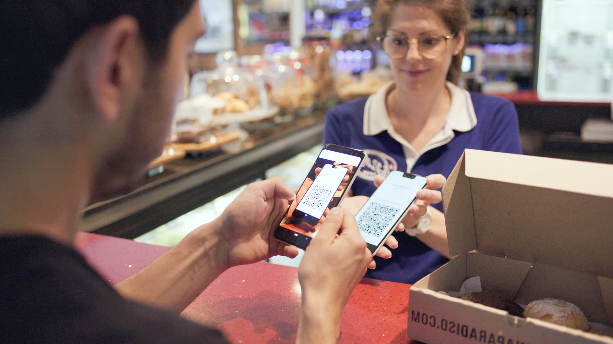

Celo is an open platform
that makes financial tools accessible to anyone with a mobile phone
Notes:
Celo in a sentence is an open platform that makes financial tools accessible to anyone with a mobile phone.
To quickly break that down,
an open platform in that we are built on a cryptographic network (like bitcoin or ethereum) that will be open source and decentralized
financial tools in that we imagine current features of money but also new ones, one of which we are talking about today.
Anyone in that we’re imagining a global borderless system that is accessible from a mobile phone and designed with the end user in mind.
HOW we design with the end user comes down to research!

Slide 4
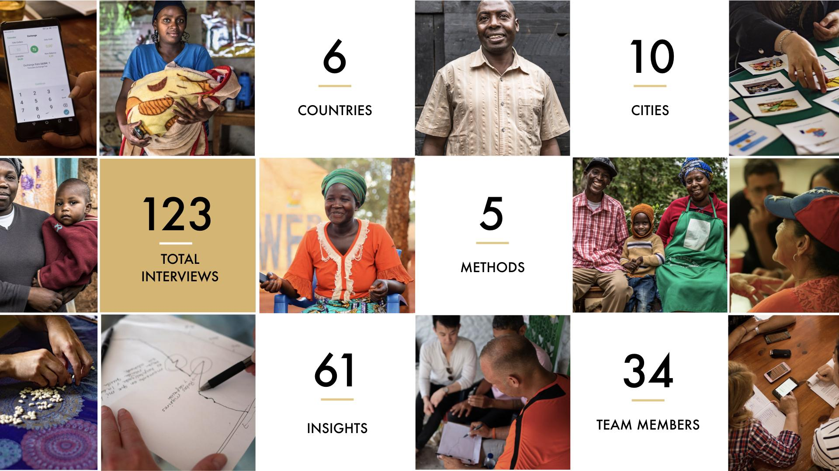
18
7
Cities
Countries
39
150
+
Team
Members
User Research Interviews
6
90
+
Methods
Insights
Notes:
We’ve held 150 user research interviews in the field, held in 7 countries

Slide 5
What we’ve learned
Notes:
Let me share with you the lessons learnt
Ultimately, the big takeaway is when it touches people’s money it’s all about trust
Let’s break that down:
It starts with awareness,
then understanding,

Slide 6

1. Awareness

Slide 7
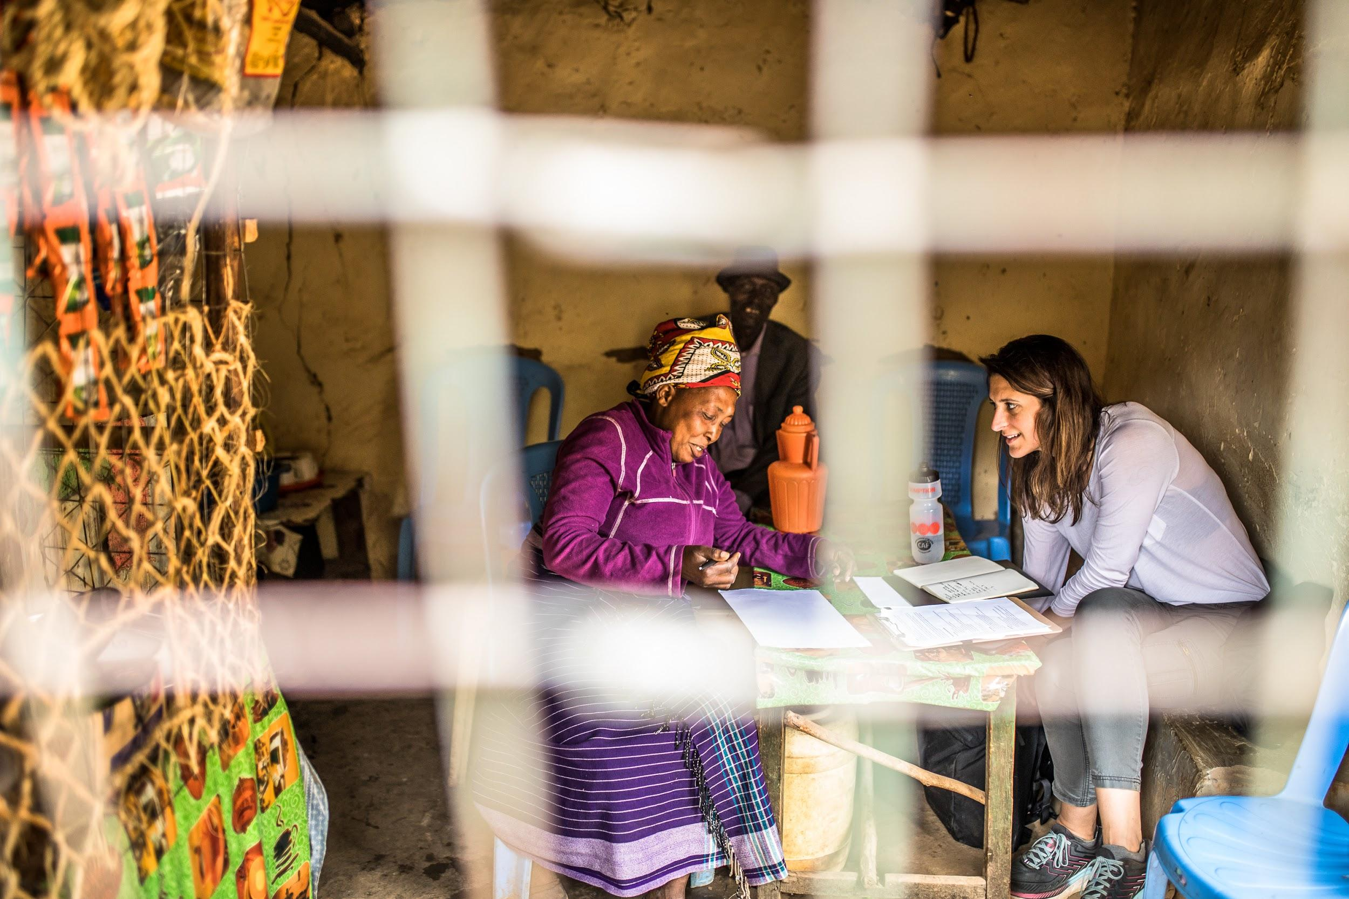
“I’ve not put into my head to know what Facebook is for.”
Kenyan Businesswoman
Notes:
From Facebook to cryptocurrencies, participants shared that many times they don’t spend any time thinking about new concepts, even if they were familiar with the terms.
This was drastically different to when MPESA was introduced as “send and receive money in the air” and people were intrigued by the idea because they already were sending money home via taking a bus.

Slide 8
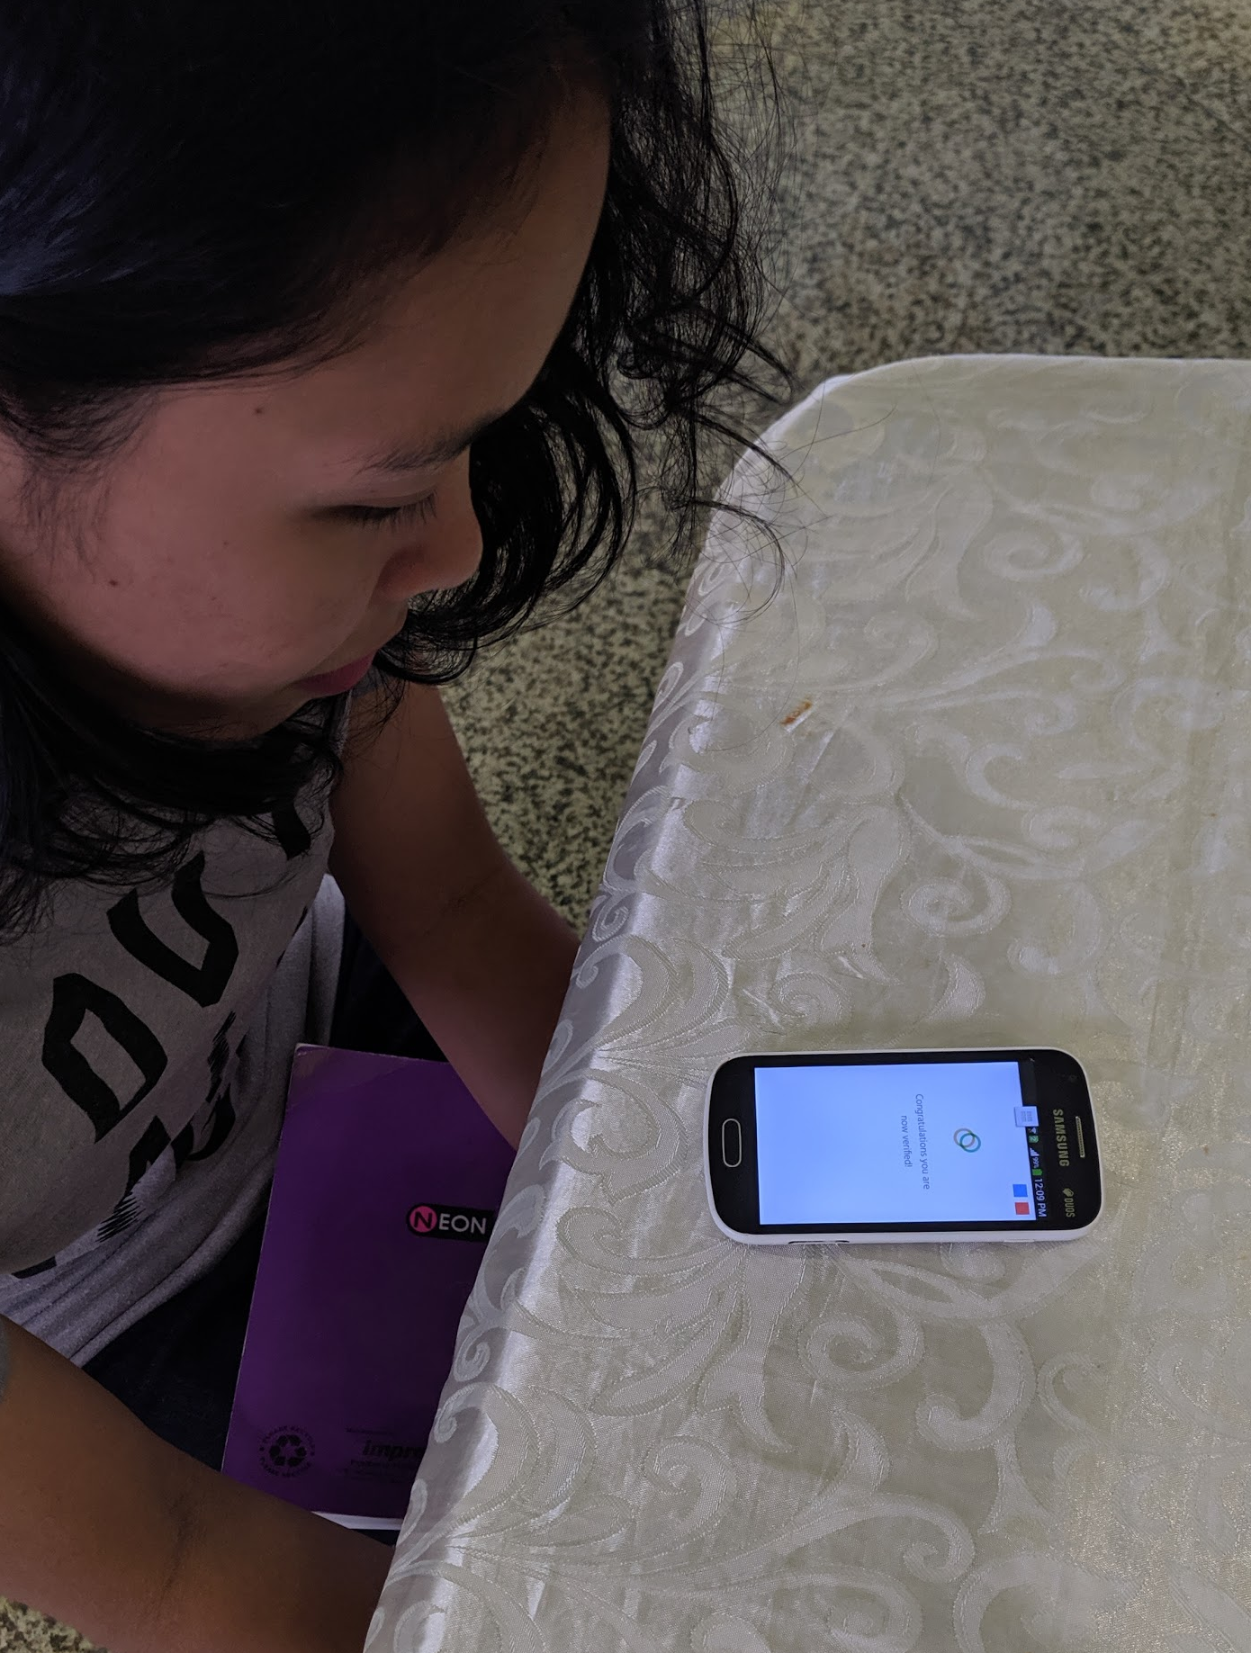
Awareness
People won’t pay attention unless you speak to their need
Notes:
Solution: think about the messaging and positioning and test it (we’ve run tests in different markets), community-based education is also really bug.

Slide 9
2. Understanding

Slide 10
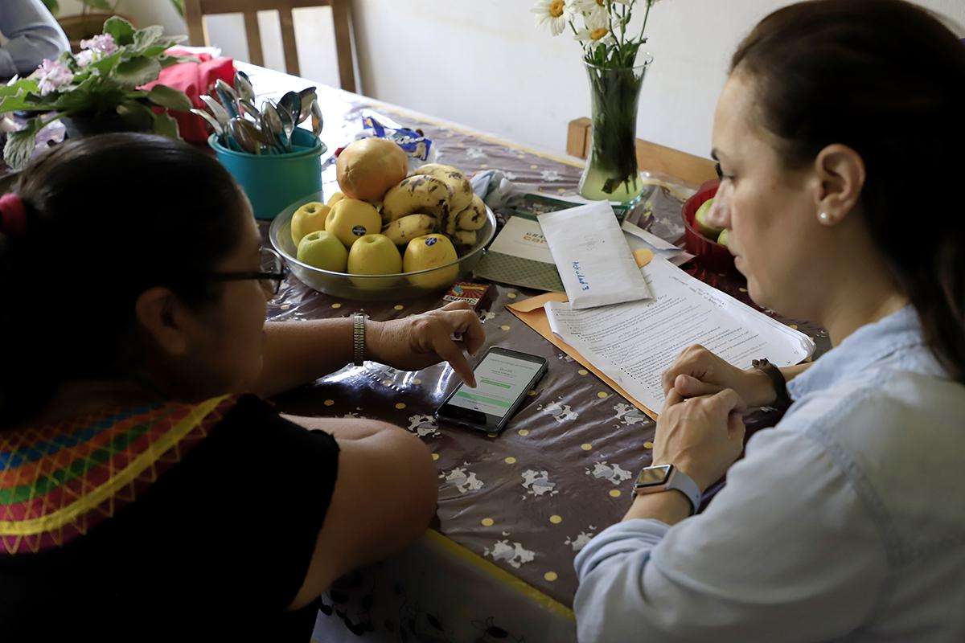
“I don't work with dollars.”
Argentine Artisan
Notes:
Many people wanted to know the exchange rate for pesos to dollars, and have habits of frequently checking the exchange rate (almost a hobby). We heard in multiple countries that you don’t pay friends (pay and receive are for work). But you can send money to friends. They have no concept of investing because they are generally focused on meeting their basic needs.
People don’t get the concept of Celo Gold (ETH) and gas

Slide 11
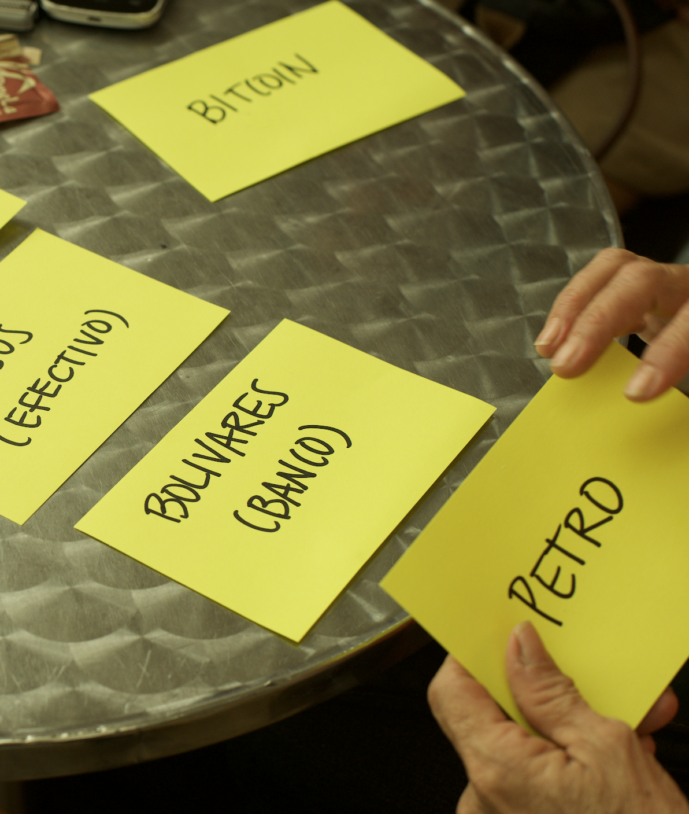
Understanding
People put new concepts into existing frameworks
Notes:
Solution: add local currencies in app and also Celo will support multiple currencies in the future. Also, from a technology standpoint, we made it possible to pay for gas in the stable value currency (Celo Dollars).

Slide 12
3. Trust
Notes:
Overview of all of our research to date

Slide 13
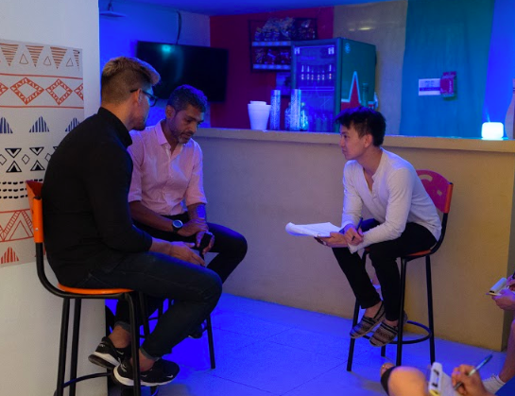
“My guy just has a table out front of his house. He has a Venezuelan flag flying and traditional llanero music playing. He always offers me a cup of coffee while we chat.”
Venezuelan Migrant
Notes:
It’s much harder for people to trust a faceless organization than a real person.
With a real person, people know where to go if there is a problem. In addition, stories about bad experiences can travel quickly and tarnish brands. Keeping things personal keeps the blame at the person level and away from the organization. This works well for decentralization. I found most interesting is that people loved MPESA but not Safaricom. Distrust of banks was common in Mexico, Venezuela, and Argentina.

Slide 14
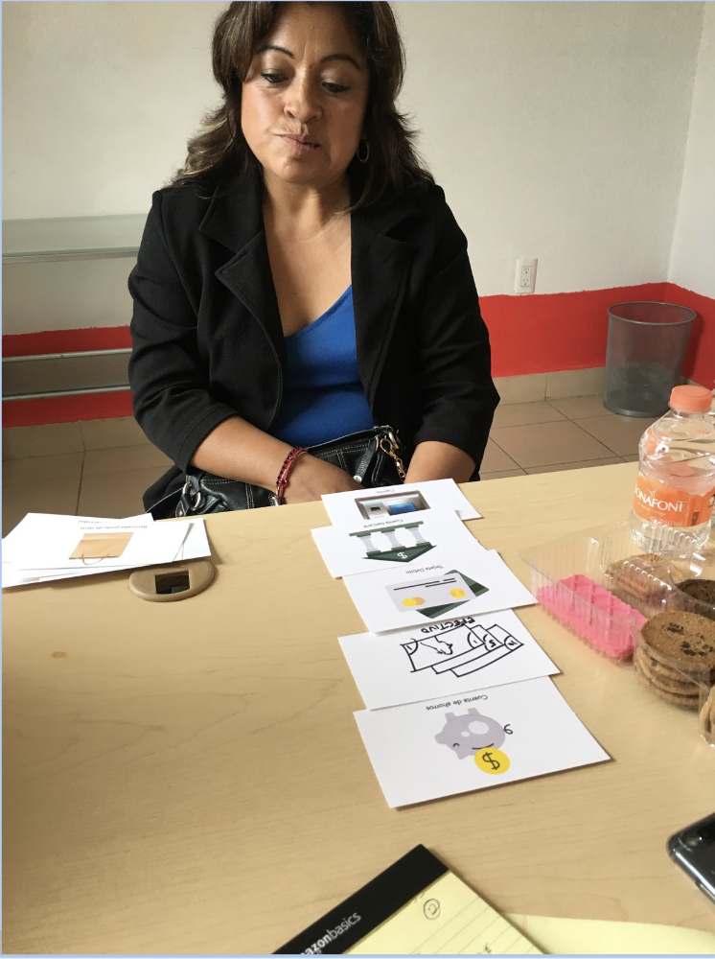
Trust
People trust people, not organizations
Notes:
Solution: Redesigned our website from illustrations to heavy photos. Focus on in person cash-in, cash-out solutions (versus expecting people to go to exchanges).

Slide 15
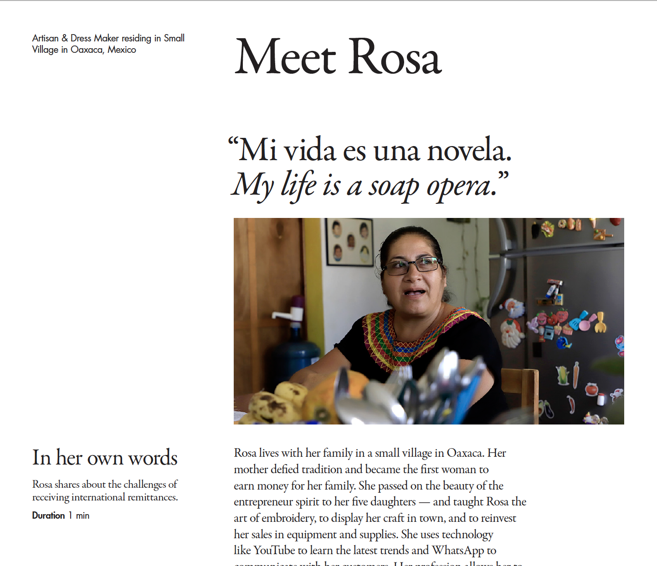
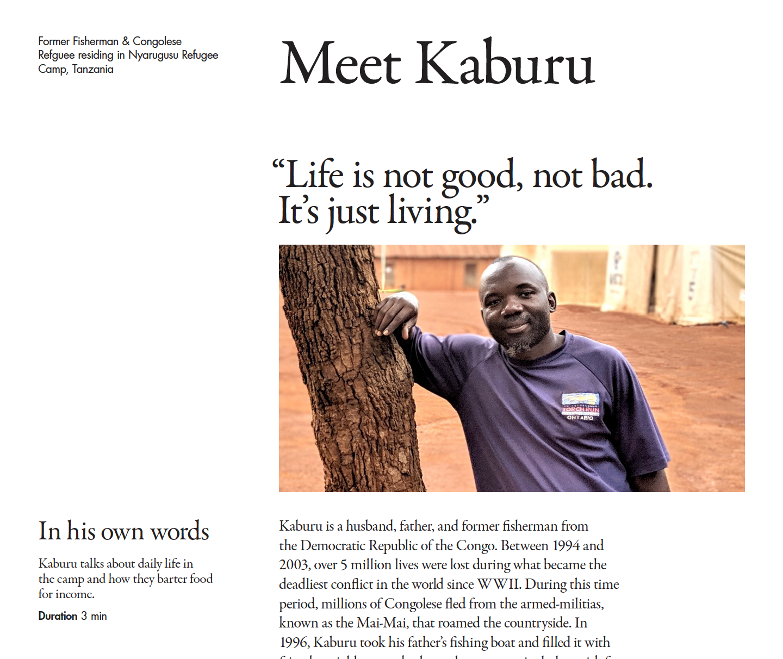

Come by the Celo booth (Umieru Cube, 3rd Floor)
Notes:
Listen to audio, build empathy and get inspired

Slide 16
We value your time
@clairebelmont @CeloHQ DeFi.WTF Osaka 2019
Notes:
If you want to learn more about research, that’s my twitter and also my telegram. Happy to talk more!

